Slide 1
FoodGapp
a solution for food waste in Delaware

Slide 2
The challenge
Develop a tool that allows the Food Bank of Delaware, our Hunger Relief Partners, and our volunteers to better coordinate efforts to reduce food waste and maximize opportunities for volunteers.

Slide 3
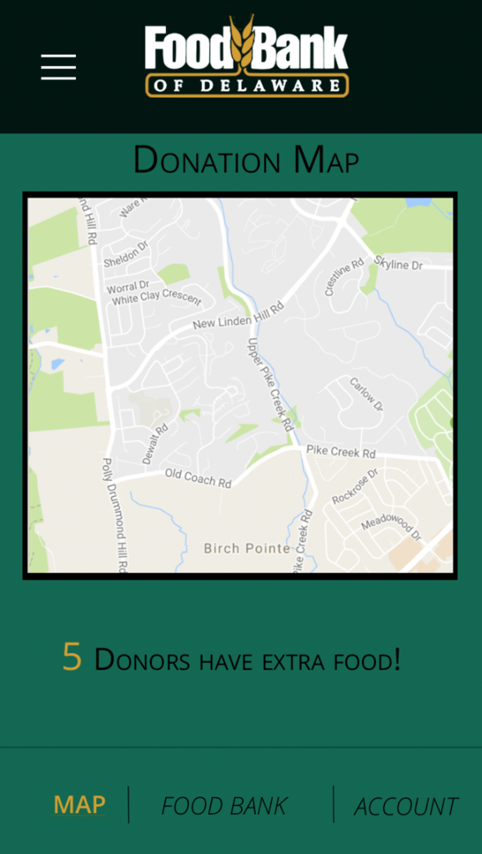
Our solution: FoodGapp
In order to harness the potential of excess food that restaurants would normally discard, the enthusiasm of Food Bank volunteers, and the robust network of Hunger Relief Partners, our app will connect volunteer drivers to food pickup opportunities in real time, using location data and openly available restaurant data, and route those drivers to nearby Hunger Relief Partners who are open to receiving donations at that time.

Slide 4
Relevant users
Donor
A restaurant or other food establishment that has potential food waste that they would like to donate.
Address information is pulled from the Restaurant Inspect Violations API
Volunteer
In the scope of this app, a Volunteer is a driver who will pick up food from a Donor and transport it to a Hunger Relief Partner.
Destination
Hunger Relief Partners, for whom we have available name, location, and phone number data, are the endpoint Destination.
They will need a point of contact to create an account and add the hours in which they are open for deliveries.

Slide 5
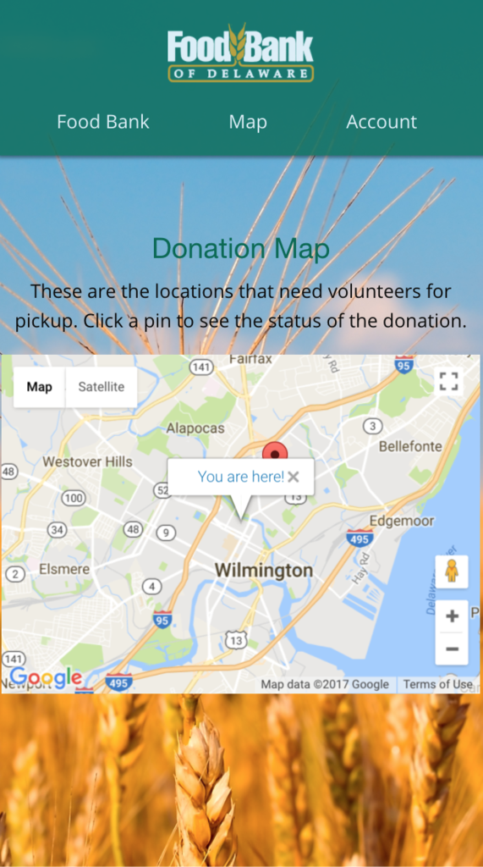
Relevant user events
Donor posts a pickup, which creates a Pickup object that is sent to a table of open Pickups. The object contains the restaurant’s name and address, a status field, an initially blank Volunteer and Destination field, plus a quantity and isPerishable field which are manually populated by the Donor.
After Volunteer sign-in, Volunteer’s landing page displays a map containing a visual representation of open Pickups within certain geographic region. For the time being, there will be a default radius for the map of posted Pickups.

Slide 6
Relevant user events
Volunteer clicks on the pin associated with an open Pickup, which opens a page displaying the location, name, and offering of the Donor, plus the nearest open Destination. The Volunteer will have the option to click an “accept” button or go back to the larger map.
Upon clicking “accept”, the Pickup object will be changed to include the Volunteer and Destination and indicate that it has been accepted. The Donor will be notified of the pending arrival and sent an ETA, and both Donor and Volunteer will be directed to a page that allows them to contact one another.
After the pickup is made, the Pickup status will be changed again, and the Destination will be notified that a delivery is on the way.

Slide 7
Benefits for the Food Bank of Delaware
Lowering the barrier for communication between Donors, Volunteers, and Destinations will increase the community’s ability to prevent food waste and allocate resources. Enhancing the precision and ease of communication between these actors will make donation and volunteering and more attractive proposition.
Meanwhile, FBD can scale down their day-to-day role in coordinating volunteers and focus on decision-making.
Some areas will invariably have an excess of unaccepted Pickups and too few Volunteers, while other areas may have the opposite problem. Robust data on these inequalities can help better inform FBD’s allocation of resources for transportation and volunteer outreach.

Slide 8
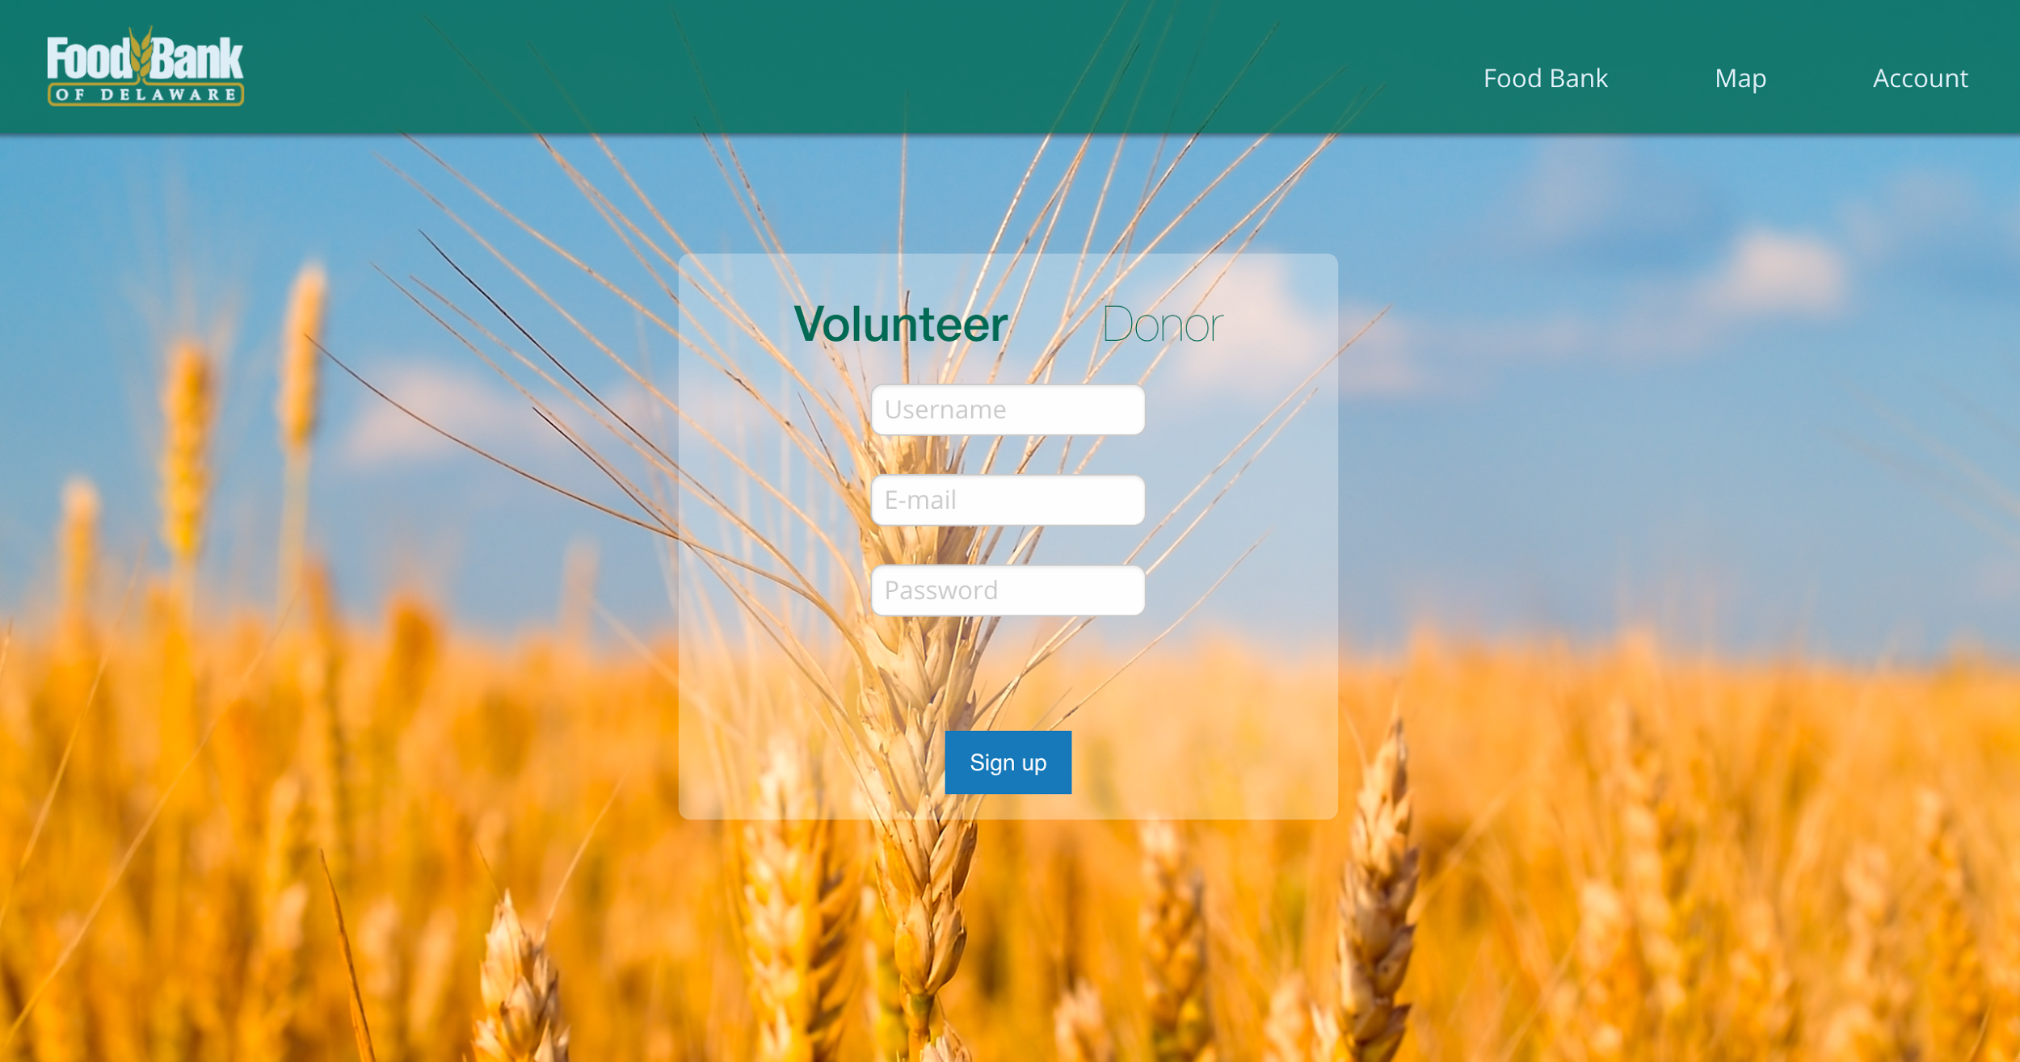
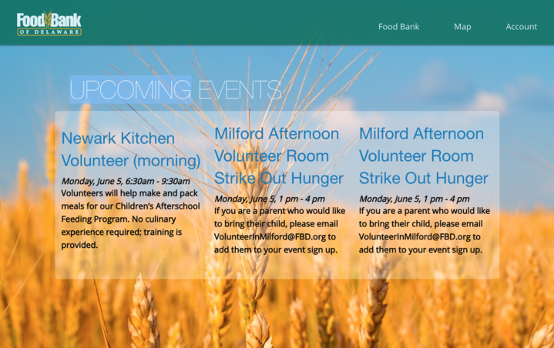
Next steps
Set up Restful Node.js API backend.
Extend app to handle volunteer signup for scheduled events.
Meet with and/or survey all potential user groups to determine additional functionality.
Coordinate with FBD to reach out to potential donors and Hunger Relief Partners.

Slide 9
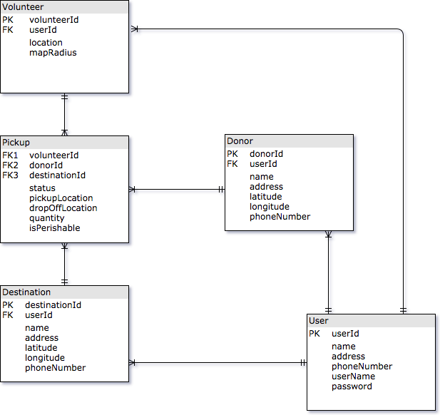
Schema

Slide 10
